Slide 1
STAT 348 – Final Project
Restaurant Revenue Prediction
A project by
Hongting (Ketherine) Wang

Slide 2
Problem Background
Kaggle Regression Competition
Predict annual restaurant revenue from 42 features
  Id: Restaurant Id
  Open Date (Date): Opening Date for A Restaurant
  City (Categorical): City Name of the Restaurant
  City Group (Categorical): Type of the City
    Big Cities/Other
  Type (Categorical): Type of the Restaurant
    DT: Drive Through/FC: Food Court/IL: Inline, MB: Mobile
  P1 – P37 (Numeric): Demographic, Real Estate, and Commercial Data
  Revenue: Target Variable
    Transformed Revenue of the Restaurant in a given year
Very small training set (137 rows) vs. huge test set (100,000 rows)
Include obfuscated operational metrics (P1 – P37) and unseen levels/categories in test set
Notes:
My Kaggle project was the Restaurant Revenue Prediction competition. The task is to predict the annual revenue for 100,000 restaurant locations based on 42 features. And one challenge is that the training set is extremely small, only 137 rows, while the test set contains 100,000 rows. And many features, P1 through P37 here for example, are obfuscated operational indicators with unknown meaning, so we don’t know what they are at all except they’re numeric, and the test set also contains unseen categories compared to the train set.

Slide 3
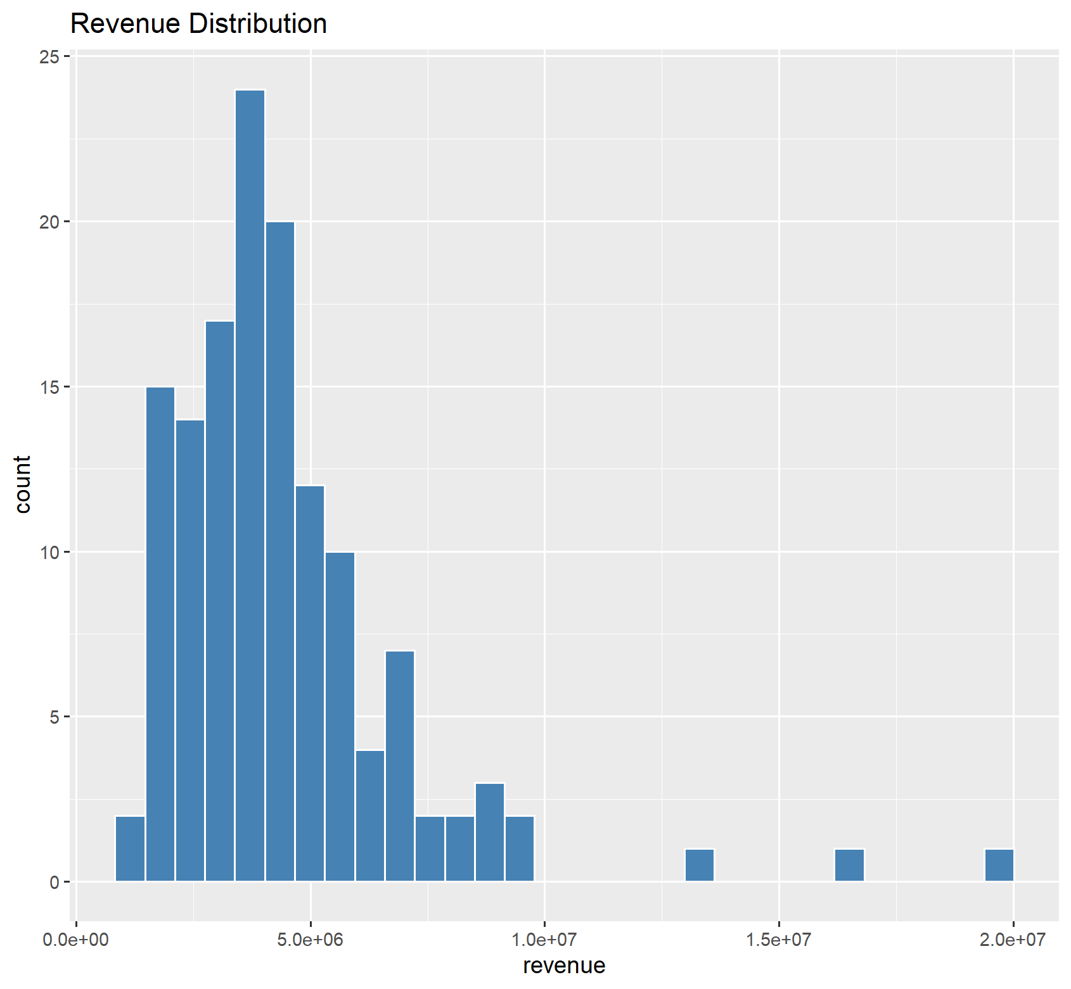
Feature Engineering
Remove two extreme revenue outliers (revenue > 15,000,000)
Extracted Day, Month, Year, Days Open (today’s date – open date) from Open Date
Converted categorical fields: Type, City Group
Removed non predictive and redundant fields: Id, City, Open Date (original)
Preprocessing Recipes
  Linear Models: Unknown/Novel Handling + Dummy Encoding + Normalization
  Tree Models: Unknown/Novel Handling + Dummy Encoding
Notes:
So to prepare the data, I first identified and removed two extreme outliers in the training set. And I engineered time-based features from the Open Date column, including Day, Month, Year, and Days Open which captures how long the restaurant has been operating. Then I converted categorical variables into factors as always and removed nonpredictive features like Id and the original Open Date which is just a date field.
And one feature engineering step that really helped was removing the City column entirely. City was a high cardinality variable. There were 34 distinct city names and 22 of them appeared only once or twice among the 137 training observations. Essentially, city names are just obfuscated identifiers, not real geographic or economic features. They aren’t necessarily semantically meaningful because they don’t really carry any interpretable information. City Group, on the other hand, already captures the important structure, whether the city is a big city or other, without the noise of the raw City field. So removing City actually reduces noise, prevents overfitting, and improves generalization.
And I implemented two preprocessing recipes. Both recipes used unknown and novel handling to create placeholders for the unseen levels in the test set, and dummy encoding for the low cardinality categorical predictors like City Group and Type. Linear models additionally required numeric scaling.

Slide 4
Model Comparison
Models Evaluated:
Kaggle RMSE:
Project Cutoff: 1,757,539
Observations
Elastic Net Regression
Random Forest (BEST)
XGBoost
1,752,060
1,613,431
1,671,891
Tree-based models outperform linear
Random Forest is more stable on small datasets
XGBoost struggled with limited sample size
Notes:
For model comparison, I evaluated and tuned three different modeling methods: first is Elastic Net Regression, and then Random Forest, and lastly XGBoost. Based on Kaggle’s RMSE metric, which is the smaller the better, the best model was Random Forest at approximately 1.61 million. XGBoost also performed well at 1.67 million, but its boosting mechanism struggled slightly due to the extreme small training size. And Elastic Net gave a reasonable baseline but was less expressive for this dataset. Overall tree ensemble methods captured nonlinear interactions more effectively than linear techniques.

Slide 5
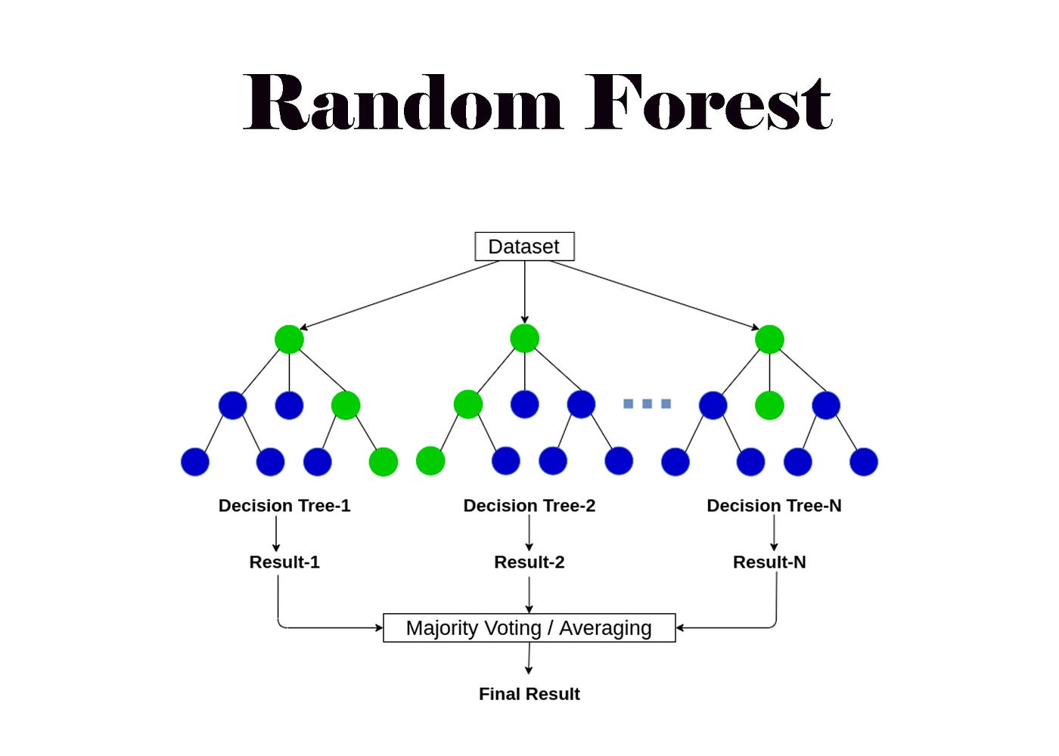
Random Forest Algorithm
Random Forest Overview
  Ensemble of Decision Trees
  Uses Bootstrap Sampling
  Random Feature Selection at Each Split
  Predictions Averaged across Trees
  Naturally Handles Nonlinearities & Interactions
Key Hyperparameters Tuned
  mtry: number of variables sampled per split
  min_n: minimum observations in leaf
  trees: 35
Why It Outperformed Others
  Robust to Overfitting on Small Datasets
  Captures Nonlinear Relationships in P1 – P37
  Insensitive to Scaling and Outliers
Notes:
And why did Random Forest worked best. So first of all, an overview, a Random Forest builds many decision trees, each trained on a boostrap sample. At every split, it randomly selects a subset of features, which reduces correlation between trees. The final prediction is the average of all tree outputs for this regression problem. This ensemble structure reduces variance and prevents overfitting, which is especially important in extremely small datasets like this one.
I tuned two key hyperparameters: mtry, the number of features considered at each split, and min_n, the minimum number of samples required in terminal node. By tuning these hyperparameters using reasonable ranges in the context of such a small sample size, it allowed the model to balance complexity and stability.
My understanding of the reason why Random Forest outperformed the other models is because it handles nonlinear interactions well, especially in the obfuscated P-variables, and it’s naturally robust to noise, scaling differences, and small-sample variance.

Slide 6
Final Results & Key Takeaways
Key Takeaways
  Feature engineering had major impact
  Tree methods outperform linear for this dataset
  Random Forest is most stable with limited data
  All models met the project cutoff
Notes:
And here’re the final scores for all three models. They all met the project cutoff which is 1.757 million, but key takeaways are tree-based models were better suited for this dataset, and Random Forest provided the best balance of bias and variance given the small training size, and extracting meaningful date components and removing nonpredictive features also had major impact.

